Slide 1
Are You Tired of Regular Excel Format? Data Visualization!!
0656120 胡瑞中
0656095 江茂榮
0656005 吳亭葳

Slide 2
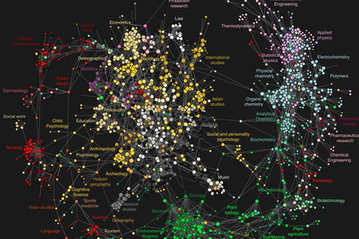
Motivation
Data collection is everywhere
Data visualization
Help designers
Help researchers
Use python

Slide 3

Python library – Bokeh 0.12.13
Interactive visualization library through web browsers
Without Javascript

Slide 4
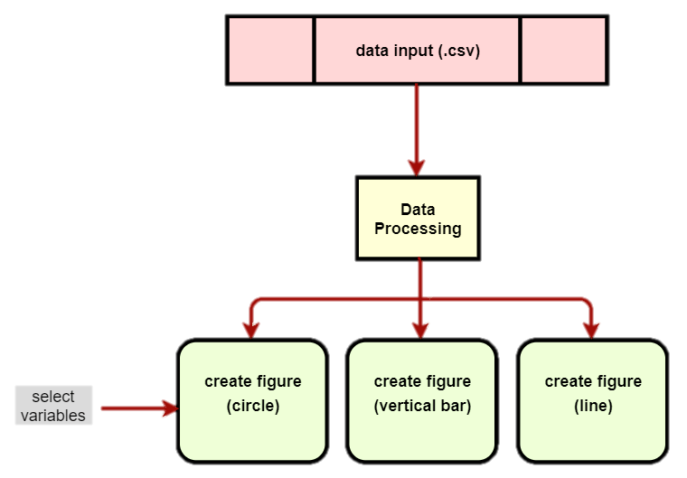
Program Architecture
https://www.quandl.com/
Notes:
csv資料來源 https://www.quandl.com/

Slide 5
Demo

Slide 6
Python Parallelism

Slide 7
Evaluation

Slide 8
Contributions

Slide 9
Conclusion

Slide 10
Q & A

